Slide 1
EE204 Computer Architecture
Lecture 04- Decision Instructions

Slide 2
Two “Logic” Instructions
Here are 2 more new instructions
Shift Left: sll $s1,$s2,2 #s1=s2<<2
Store in $s1 the value from $s2 shifted 2 bits to the left, inserting 0’s on right; << in C
Before: 0000 0002_{hex} 0000 0000 0000 0000 0000 0000 0000 0010_{two}
After: 0000 0008_{hex} 0000 0000 0000 0000 0000 0000 0000 1000_{two}
What arithmetic effect does shift left have?
Shift Right: srl is opposite shift; >>

Slide 3
MIPS Control Flow Instructions
MIPS conditional branch instructions:
bne $s0, $s1, Lbl#go to Lbl if $s0≠$s1 beq $s0, $s1, Lbl#go to Lbl if $s0=$s1
Ex: if (i==j) h = i + j;
bne $s0, $s1, Lbl1 add $s3, $s0, $s1 Lbl1: ...
Instruction Format (I format):
op rs rt 16 bit offset
How is the branch destination address specified?

Slide 4
More Branch Instructions
We have beq, bne, but what about other kinds of brances (e.g., branch-if-less-than)? For this, we need yet another instruction, slt
Set on less than instruction:
slt $t0, $s0, $s1 # if $s0 < $s1 then # $t0 = 1 else # $t0 = 0
Instruction format (R format):
op rs rt rd funct
2

Slide 5
More Branch Instructions, Con’t
Can use slt, beq, bne, and the fixed value of 0 in register $zero to create other conditions
less than blt $s1, $s2, Label
less than or equal to ble $s1, $s2, Label
greater than bgt $s1, $s2, Label
great than or equal to bge $s1, $s2, Label
slt $at, $s1, $s2 #$at set to 1 if
bne $at, $zero, Label # $s1 < $s2
Such branches are included in the instruction set as pseudo instructions - recognized (and expanded) by the assembler
Its why the assembler needs a reserved register ($at)
Notes:
For lecture
blt $s1,$s2 Label =
slt $at,$s1,$s2 #at gets 1 if $s1 < $s2
bne $at,$zero,Label

Slide 6
Other Control Flow Instructions
MIPS also has an unconditional branch instruction or jump instruction: j label #go to label
Instruction Format (J Format):
op 26-bit address
from the low order 26 bits of the jump instruction
26
00
32
4
PC
32
Notes:
If-then-else code compilation

Slide 7
Aside: Branching Far Away
What if the branch destination is further away than can be captured in 16 bits?
The assembler comes to the rescue – it inserts an unconditional jump to the branch target and inverts the condition
beq $s0, $s1, L1
becomes
bne $s0, $s1, L2
j L1
L2:

Slide 8
Instructions for Accessing Pocedures
MIPS procedure call instruction: jal ProcedureAddress #jump and link
Saves PC+4 in register $ra to have a link to the next instruction for the procedure return
Machine format (J format):
Then can do procedure return with a
jr $ra #return
Instruction format (R format):
op 26 bit address
op rs funct
Notes:
jr jumps to the address stored in the register – in this case $ra – which is just what we want.

Slide 9
MIPS Immediate Instructions
Small constants are used often in typical code
Possible approaches?
put “typical constants” in memory and load them
create hard-wired registers (like $zero) for constants like 1
have special instructions that contain constants !
addi $sp, $sp, 4 #$sp = $sp + 4
slti $t0, $s2, 15 #$t0 = 1 if $s2<15
Machine format (I format):
op rs rt 16 bit immediate
I format
The constant is kept inside the instruction itself!
Immediate format limits values to the range +2¹⁵–1 to -2¹⁵
Notes:
in gcc 52% of arithmetic operations involve constants – in spice its 69%
have the students answer why not – speed and limited number of registers
much faster than if loaded from memory
addi and slti do sign extend of immediate operand into the leftmost bits of the destination register (ie., copies the leftmost bit of the 16-bit immediate value into the upper 16 bits)
by contrast, ori and andi loads zero’s into the upper 16 bits and so is usually used (instead of the addi) to build 32 bit constants

Slide 10
MIPS ISA So Far
Category | Instr | Op Code | Example | Meaning
Arithmetic (R & I format) | add | 0 and 32 | add $s1, $s2, $s3 | $s1 = $s2 + $s3
 | subtract | 0 and 34 | sub $s1, $s2, $s3 | $s1 = $s2 - $s3
 | add immediate | 8 | addi $s1, $s2, 6 | $s1 = $s2 + 6
 | or immediate | 13 | ori $s1, $s2, 6 | $s1 = $s2 v 6
Data Transfer (I format) | load word | 35 | lw $s1, 24($s2) | $s1 = Memory($s2+24)
 | store word | 43 | sw $s1, 24($s2) | Memory($s2+24) = $s1
 | load byte | 32 | lb $s1, 25($s2) | $s1 = Memory($s2+25)
 | store byte | 40 | sb $s1, 25($s2) | Memory($s2+25) = $s1
 | load upper imm | 15 | lui $s1, 6 | $s1 = 6 * 2¹⁶
Cond. Branch (I & R format) | br on equal | 4 | beq $s1, $s2, L | if ($s1==$s2) go to L
 | br on not equal | 5 | bne $s1, $s2, L | if ($s1 !=$s2) go to L
 | set on less than | 0 and 42 | slt $s1, $s2, $s3 | if ($s2<$s3) $s1=1 else $s1=0
 | set on less than immediate | 10 | slti $s1, $s2, 6 | if ($s2<6) $s1=1 else $s1=0
Uncond. Jump (J & R format) | jump | 2 | j 2500 | go to 10000
 | jump register | 0 and 8 | jr $t1 | go to $t1
 | jump and link | 3 | jal 2500 | go to 10000; $ra=PC+4
Notes:
similarity of the binary representation of related instructions simplifies the hardware design

Slide 11
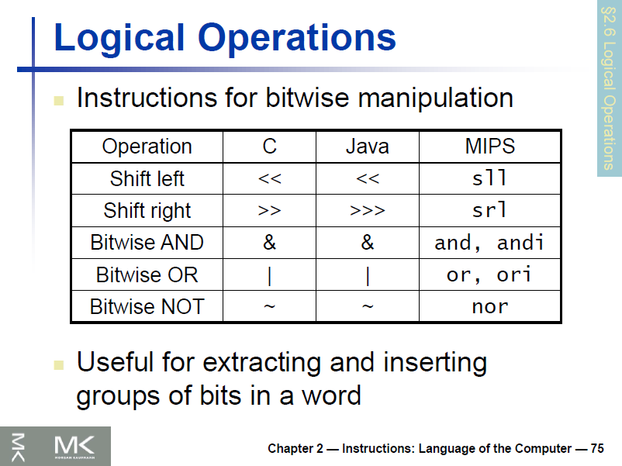

Slide 12
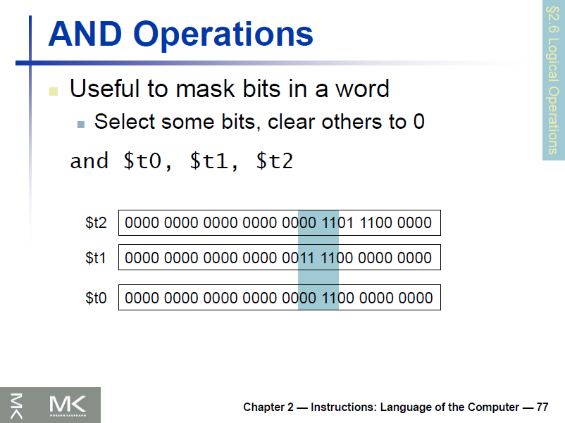

Slide 13
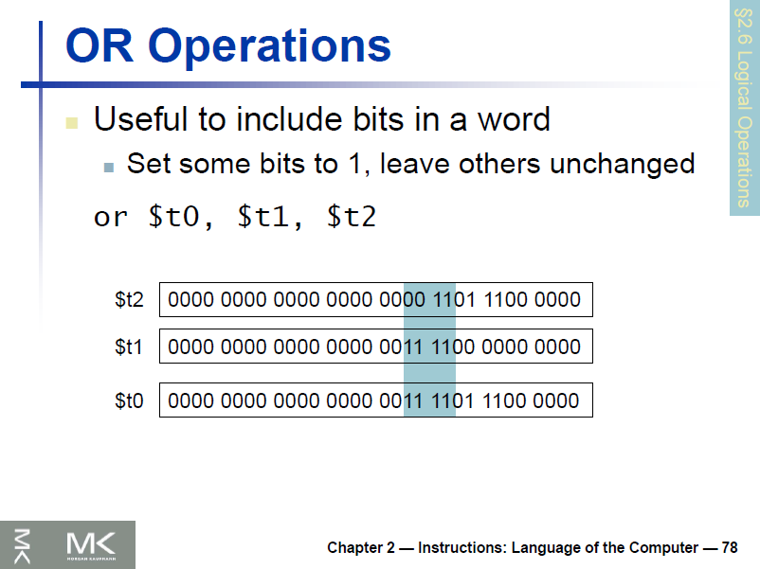

Slide 14
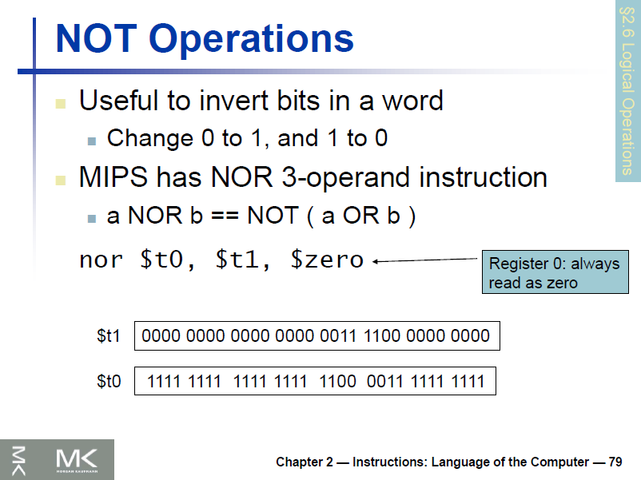

Slide 15
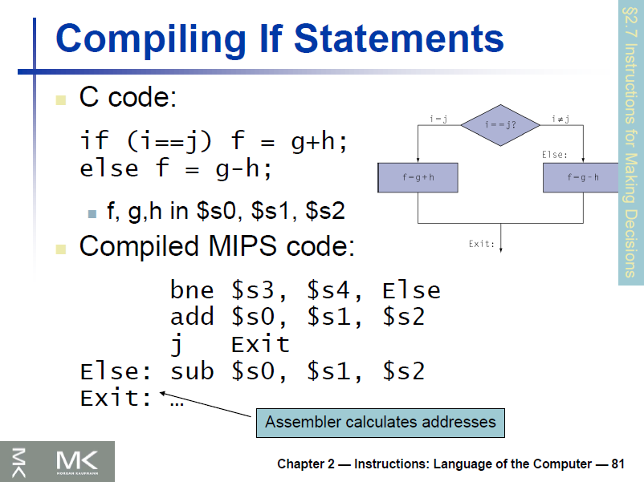

Slide 16
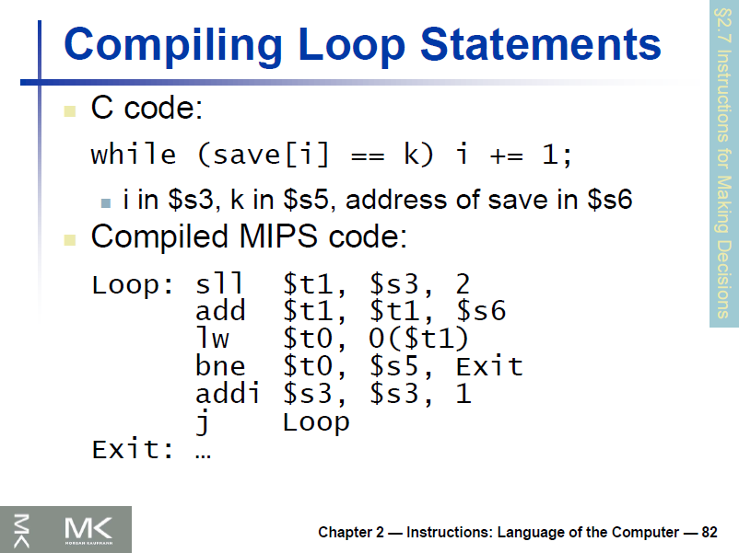

Slide 17
Example: The C Switch Statement (1/3)
Choose among four alternatives depending on whether k has the value 0, 1, 2 or 3. Compile this C code: switch (k) { case 0: f=i+j; break; /* k=0 */ case 1: f=g+h; break; /* k=1 */ case 2: f=g–h; break; /* k=2 */ case 3: f=i–j; break; /* k=3 */ }

Slide 18
Example: The C Switch Statement (2/3)
This is complicated, so simplify.
Rewrite it as a chain of if-else statements, which we already know how to compile:
if(k==0) f=i+j; else if(k==1) f=g+h; else if(k==2) f=g–h; else if(k==3) f=i–j;
Use this mapping:
f:$s0, g:$s1, h:$s2, i:$s3, j:$s4, k:$s5

Slide 19
Example: The C Switch Statement (3/3)
Final compiled MIPS code: bne $s5,$0,L1 # branch k!=0 add $s0,$s3,$s4 #k==0 so f=i+j j Exit # end of case so Exit L1: addi $t0,$s5,-1 # $t0=k-1 bne $t0,$0,L2 # branch k!=1 add $s0,$s1,$s2 #k==1 so f=g+h j Exit # end of case so Exit L2: addi $t0,$s5,-2 # $t0=k-2 bne $t0,$0,L3 # branch k!=2 sub $s0,$s1,$s2 #k==2 so f=g-h j Exit # end of case so Exit L3: addi $t0,$s5,-3 # $t0=k-3 bne $t0,$0,Exit # branch k!=3 sub $s0,$s3,$s4 #k==3 so f=i-j Exit:

